Slide 1
BINARY DATA REPRESENTATION
Michael D’Argenio – mjdargen@ncsu.edu
Electrical Engineering – SS 2019 – Duke TIP

Slide 2
How do we represent data in a computer?
At the lowest level, a computer is an electronic machine.
Works by controlling the flow of electrons
Easy to recognize two conditions:
presence of a voltage – we’ll call this state “1”
absence of a voltage – we’ll call this state “0”
Could base state on value of voltage, but control and detection circuits more complex.
Early computer iterations attempted trinary and quinary systems.
Eventually settled on binary system.

Slide 3
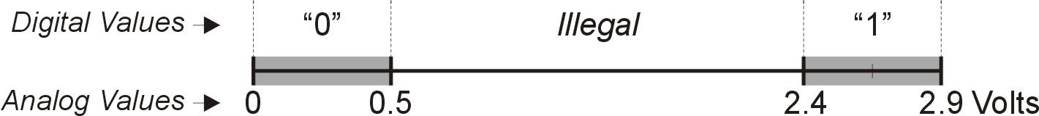
Computer is a binary digital system.
Basic unit of information is the binary digit, or bit.
Values with more than two states require multiple bits.
A collection of two bits has four possible states:
00, 01, 10, 11
A collection of three bits has eight possible states:
000, 001, 010, 011, 100, 101, 110, 111
A collection of n bits has 2^{n} possible states.
Digital system:
finite number of symbols
Binary (base two) system:
has two states: 0 and 1

Slide 4
What kinds of data do we need?
Numbers – signed, unsigned, integers, floating point, complex, rational, irrational, …
Text – characters, strings, …
Images – pixels, colors, shapes, …
Sound
Logical – true, false
Instructions
…
Data type: representation and operations within the computer

Slide 5
Unsigned Integers
Non-positional notation - could represent a number (“5”) with a string of ones (“11111”)
Weighted positional notation
Use in our decimal number system: “329”
“3” is worth 300, because of its position, while “9” is only worth 9
most
significant
least
significant
329
101
10²
10¹
10⁰
2²
2¹
2⁰
3x100 + 2x10 + 9x1 = 329
1x4 + 0x2 + 1x1 = 5

Slide 6
Unsigned Integers (cont.)
An n-bit unsigned integer represents 2^{n} values: from 0 to 2^{n}-1.
2² | 2¹ | 2⁰
0 | 0 | 0 | 0
0 | 0 | 1 | 1
0 | 1 | 0 | 2
0 | 1 | 1 | 3
1 | 0 | 0 | 4
1 | 0 | 1 | 5
1 | 1 | 0 | 6
1 | 1 | 1 | 7

Slide 7
Unsigned Binary Arithmetic
Base-2 addition – just like base-10!
add from right to left, propagating carry
carry
10010 10010 1111
+ 1001 + 1011 + 1
11011 11101 10000
10111
+ 111

Slide 8
Signed Integers
With n bits, we have 2^{n} distinct values.
assign about half to positive integers (1 through 2^{n-1}) and about half to negative (- 2^{n-1} through -1)
Most significant bit (MSB) indicates sign: 0=positive, 1=negative
Positive integers
just like unsigned – zero in MSB to show it’s positive.
00101 = 5
Negative integers
sign-magnitude – one in MSB to show it’s negative. Other bits are the same as unsigned.
10101 = -5
Note there are other signed notations we won’t cover.

Slide 9
Hexadecimal Notation
It is often convenient to write binary (base-2) numbers as hexadecimal (base-16) numbers instead.
fewer digits - four bits per hex digit
less error prone - easy to corrupt long string of 1’s and 0’s
Binary | Hex | Decimal
0000 | 0 | 0
0001 | 1 | 1
0010 | 2 | 2
0011 | 3 | 3
0100 | 4 | 4
0101 | 5 | 5
0110 | 6 | 6
0111 | 7 | 7
Binary | Hex | Decimal
1000 | 8 | 8
1001 | 9 | 9
1010 | A | 10
1011 | B | 11
1100 | C | 12
1101 | D | 13
1110 | E | 14
1111 | F | 15

Slide 10
Converting from Binary to Hexadecimal
Every four bits is a hex digit.
Start grouping from right-hand side
011101010001111010011010111
3
A
8
F
4
D
7
This is not a new machine representation, just a convenient way to write the number.

Slide 11
Fractions: Fixed-Point
How can we represent fractions?
Use a “binary point” to separate positive from negative powers of two -- just like “decimal point.”
2⁻¹ = 0.5
2⁻² = 0.25
2⁻³ = 0.125
00101000.101 (40.625)
+ 10000001.010 (-1.25)
00100111.011 (39.375)
No new operations -- same as integer arithmetic.

Slide 12

Very Large & Very Small: Floating-Point
Large values: 6.023 x 10²³ -- requires 79 bits
Small values: 6.626 x 10⁻³⁴ -- requires >110 bits
Use equivalent of “scientific notation”: F x 2E
Need to represent F (fraction), E (exponent), and sign.
IEEE 754 Floating-Point Standard (32-bits):
1b
8b
23b
S
Exponent
Fraction
$$N=(−1)^{S}×1.\text{fraction}×2^{\text{exponent}−127},1≤\text{exponent}≤254 \\ N=(−1)^{S}×0.\text{fraction}×2^{−126},\text{exponent}=0$$

Slide 13
Floating Point Example
Single-precision IEEE floating point number:
10111111010000000000000000000000
Sign is 1 – number is negative.
Exponent field is 01111110 = 126 (decimal).
Fraction is 0.100000000000… = 0.5 (decimal).
Value = -1.5 x 2⁽¹²⁶⁻¹²⁷⁾ = -1.5 x 2⁻¹ = -0.75.
sign
exponent
fraction

Slide 14
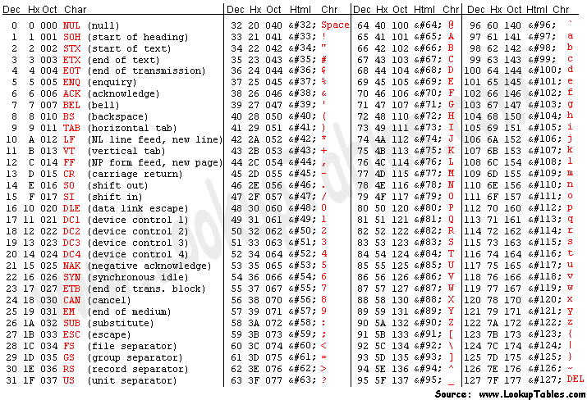
Text: ASCII Characters

Slide 15
Other Data Types
Text strings
sequence of characters, terminated with NULL (0)
typically, no hardware support
Image
array of pixels
monochrome: one bit (1/0 = black/white)
color: red, green, blue (RGB) components (e.g., 8 bits each)
other properties: transparency
hardware support:
typically none, in general-purpose processors
MMX -- multiple 8-bit operations on 32-bit word
Sound
sequence of fixed-point numbers

Slide 16
Operations: Arithmetic and Logical
Recall: a data type includes representation and operations.
In the instructions our computer operates, we have operands (values) and opcodes (type of operation).
We will have a number of arithmetic operations including:
Addition
Subtraction
Sign Extension
Important to keep track of overflow.
Multiplication, division, etc., can be built from these operations.
Logical operations are also useful:
AND
OR
NOT

